Slide 1

BEGINNER PROGRAMMING LESSON
Updating Your Software and Firmware

Slide 2
LESSON OBJECTIVES
Learn how to update the software
Learn how to update the firmware

Slide 3
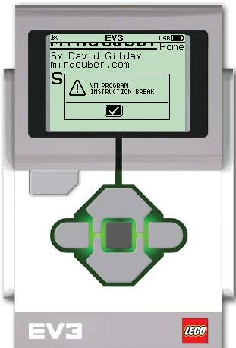
Why bother with updates?
When you first receive your EV3, you should update both your EV3 software and brick firmware versions.
Many users continue to run the default software and firmware versions.
There have been important bug fixes and new features since the EV3 first came out.
For example, the VM Program Instruction Break error was resolved in the last update in 2016.

Slide 4
NOTE: Two EDITIONS
There are two different EV3 brick firmware and programming software available: Home and Education Editions
To learn about the differences between the two, read http://ev3lessons.com/2017/01/17/Home-vs-Edu.html
Home Edition
Education Edition

Slide 5
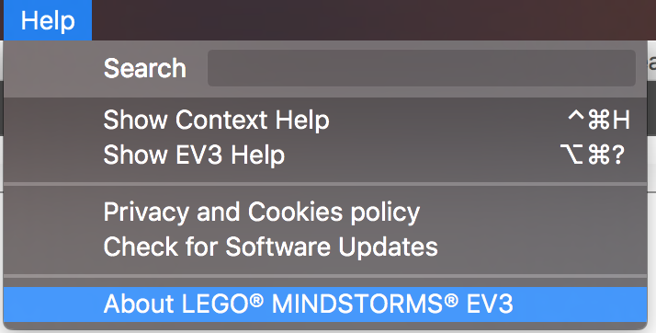
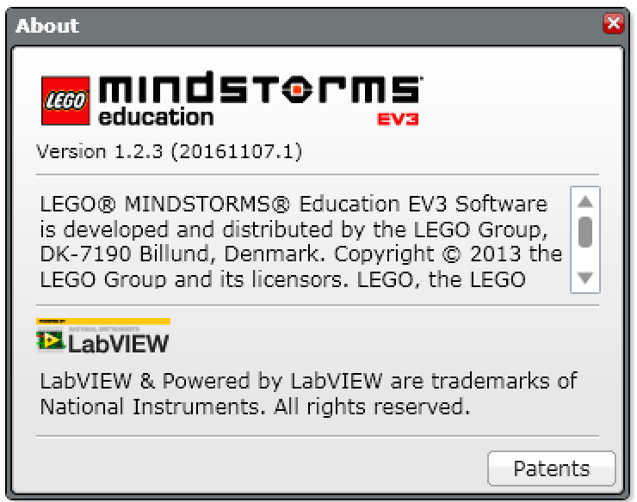
To update your SOFTWARE
Open the EV3 Programming Software you installed earlier
From the Help Menu, pick “About LEGO MINDSTORMS EV3”
A pop-up window will appear, showing the version of the software you are running (Home or Education and the Version number)
Download and install a newer version if needed from the following pages:
Home Edition Download: https://www.lego.com/en-us/mindstorms/downloads/download-software
Education Edition Download: https://education.lego.com/en-us/downloads/mindstorms-ev3

Slide 6
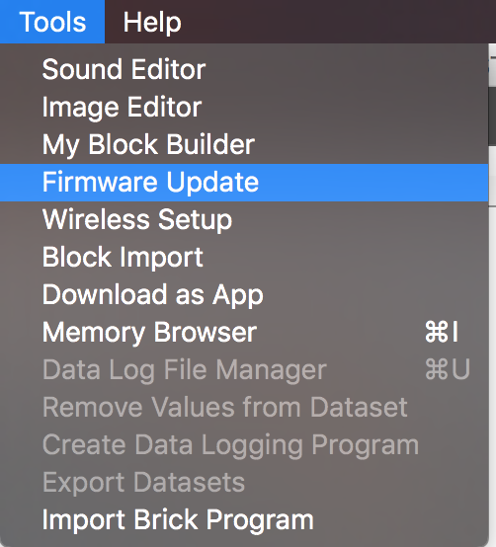
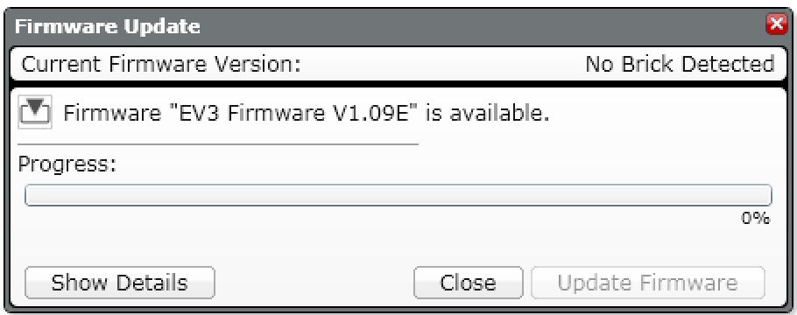
To update your firmware
Connect your EV3 to the computer
Open your LEGO MINDSTORMS EV3 Software and go to Tools Menu and click “Firmware Update”.
A pop-up window will appear, showing you the current firmware on the EV3 brick and any updates available.
Follow instructions to update your brick. If you are running the Educational version of the software, you will automatically be given Educational editions of the firmware to update.
Note: Education Edition are indicated with an “E” at the end of the version number. Home Edition is indicated with a “H”

Slide 7
CREDITS
This tutorial was created by Sanjay Seshan and Arvind Seshan
More lessons are available at www.ev3lessons.com
This work is licensed under a Creative Commons Attribution-NonCommercial-ShareAlike 4.0 International License.

